Slide 1
Linda Toto App By:
Team Tolv

Slide 2
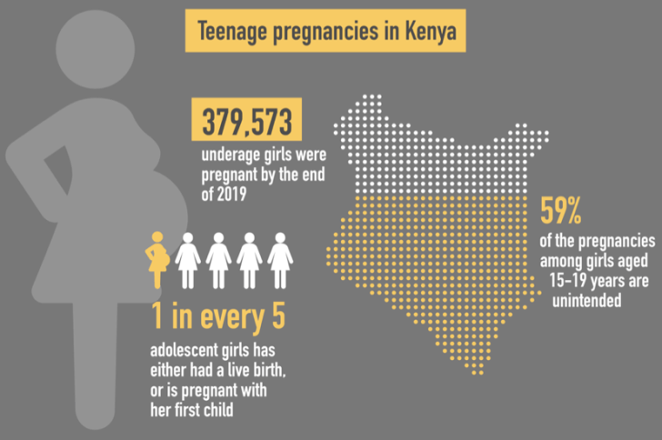

Slide 3
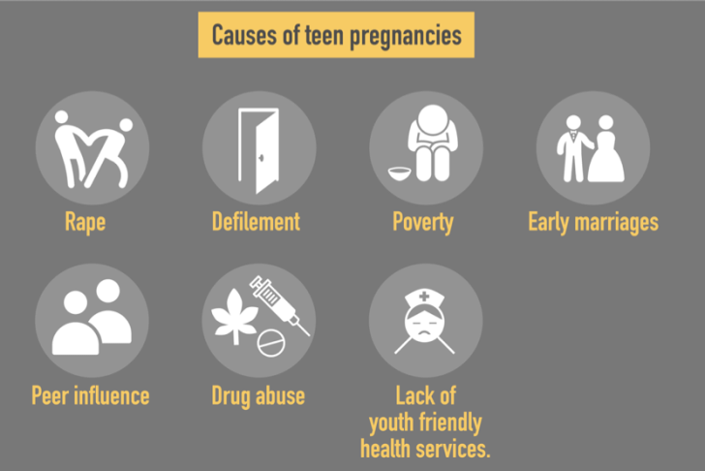
Who is to blame?

Slide 5
I would like to interrogate the rate of pregnancies because they look obnoxious,who is giving us these figures?....CS Magoha

Slide 6
Problem statement
Higher rates of teenage pregnancies during this COVID-19 Pandemic.
-Unclear/unconfirmed information on number of teen pregnancies in counties.
-Ignorance on child rights and policies to safeguard our young nation.

Slide 7
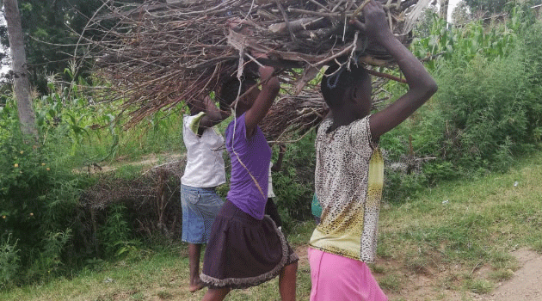
Our Motivation
There is scanty of evidence on the qualitative aspects of early child pregnancies.
Guided by this gap, our qualitative research focused on investigating the extent to which the issue of teenage pregnancy is affecting the society during demanding pandemics such as covid 19 and what role technology plays in this regard

Slide 8
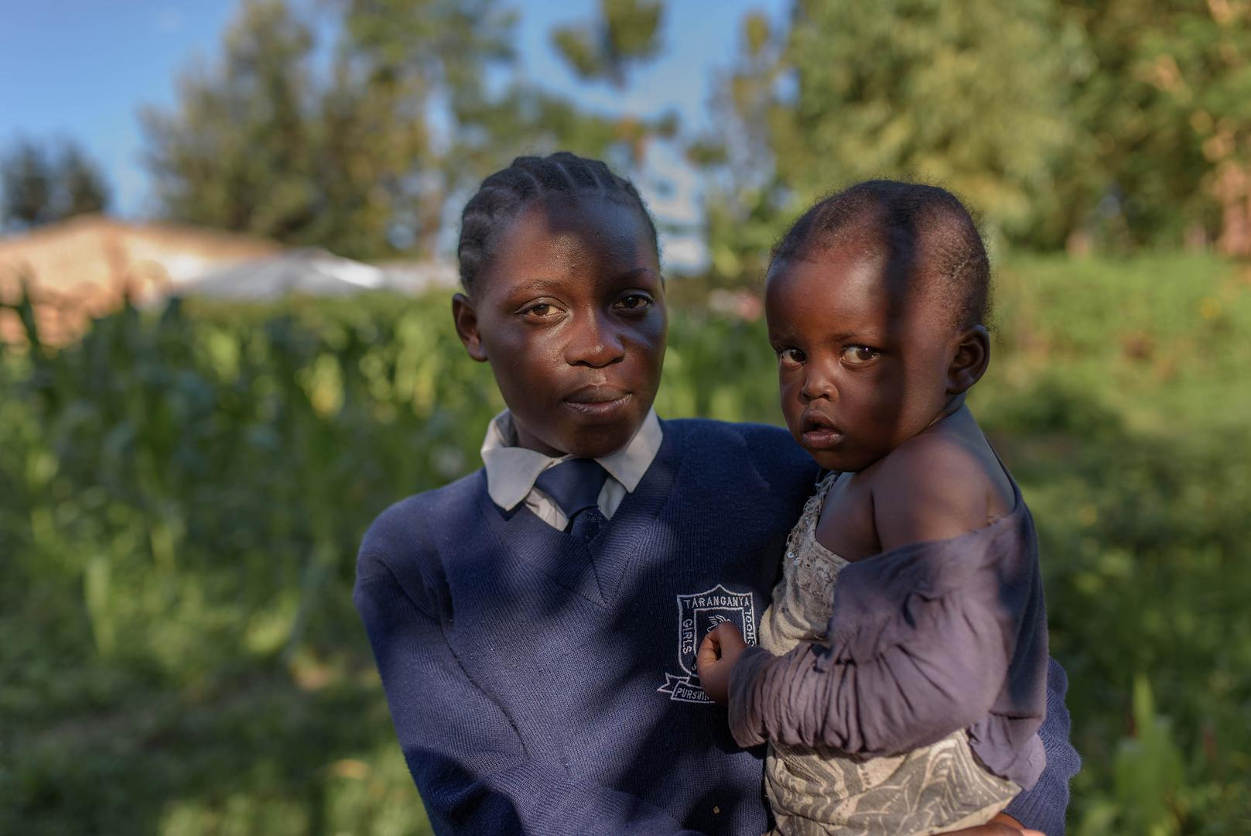
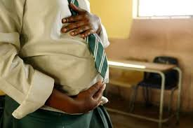
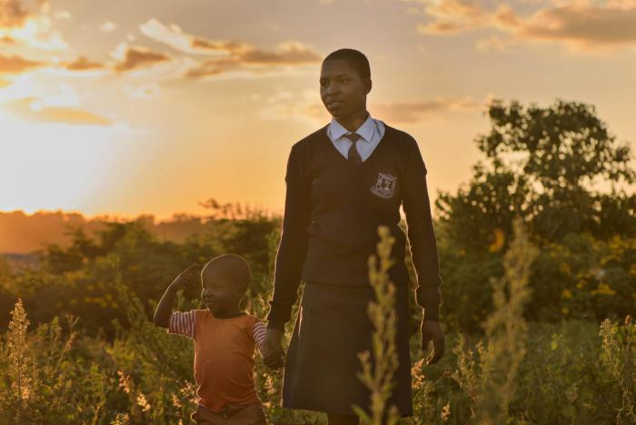
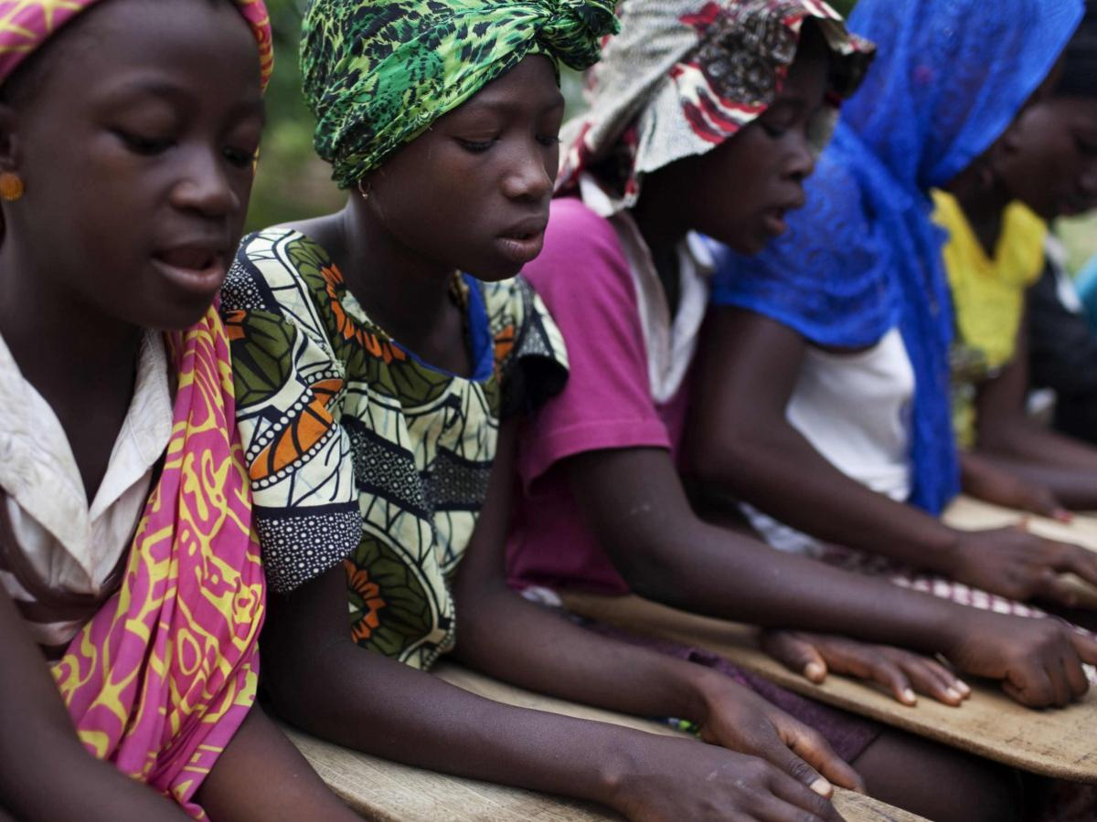
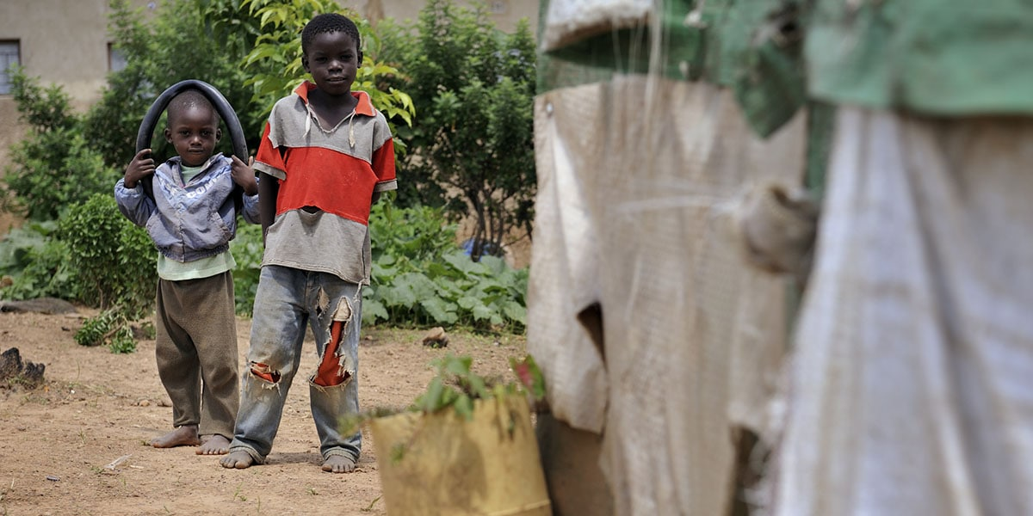
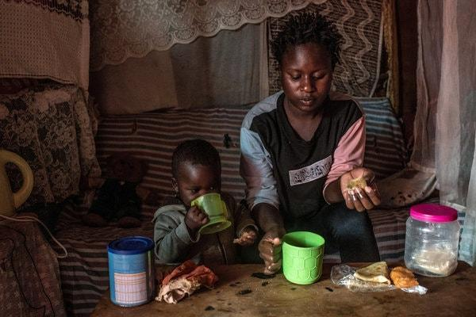
Case study Gallery

Slide 9
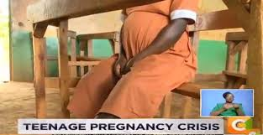
This challenge is with us!!
98% Of pregnant girls were not in school
2% of teenage mothers return to school.
59% of Pregnancies aged 15-19 years
45% of severe abortion complications reported
More than 54% Never intended for the pregnancies.

Slide 10
Project goals & objectives
Accurate numbers.
With the help of our app, precise numbers of pregnant teens will help the government and private organizations plan for better solutions to young mothers.
Health facilities
Connecting affected children to nearest health facilities so that they get the much needed medical attention .
Law enforcement
Connect children and parents/caregivers with the law enforcement officers if need be.

Slide 11
Project goals & objectives
Data analytics
Analysis of the data that will help in future predictions and future prevention of teenage pregnancies.
Covid-19
Provide information on covid-19 preventive measures.it will also provide information on prenatal care.

Slide 12
Our Solution
We have come up with a multicriterial Mobile Application that will cut down significantly on the rising number of early pregnancies from 59% to 30% on girls aged between 15-19. Our solution converts our existing challenge into a knowledge based economy where medical assistants
Will be able to offer significant assistance to these affected
age group. We also provide an easier and robust way to
track and identify affected girls, offering them assistance
and protection from recognized agencies and Institutions.

Slide 13
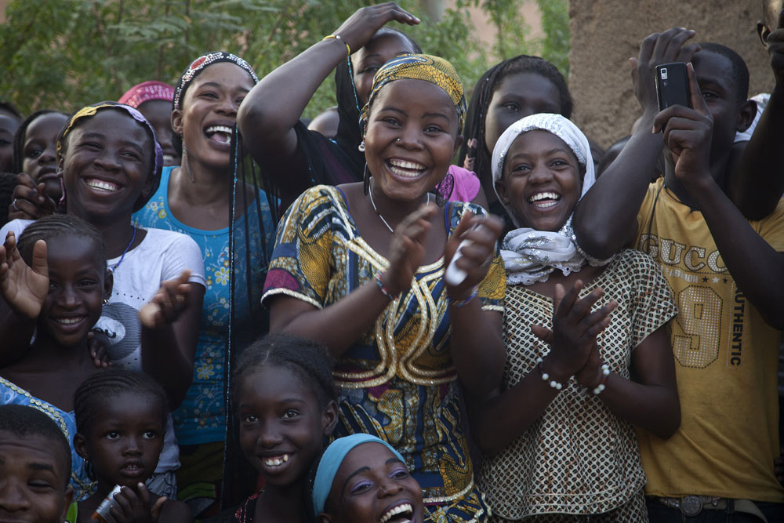
A girls life can be impacted ,protected and secured.
We believe it is possible to reduce the rate of teenage pregnancies and make it a thing of the past.
Thank you.

